Slide 1
Infosys SpringBoard
FOOD TRENDS UNDERSTANDING
CUSTOMER PREFERENCES
Group 1 – Batch 11
Team-B
Shashank Singh

Slide 2








Project Objective: Driving Data-Driven Decisions
The dashboards analyze customer behavior, sales performance, delivery operations, sentiment trends, and menu optimization. This intelligence empowers stakeholders to make informed choices that enhance business outcomes.
Customer Behavior
Sales Performance
Delivery Operations
Sentiment Trends
Understanding preferences and patterns.
Tracking revenue and growth.
Optimizing logistics and efficiency.
Gauging customer satisfaction.

Slide 3
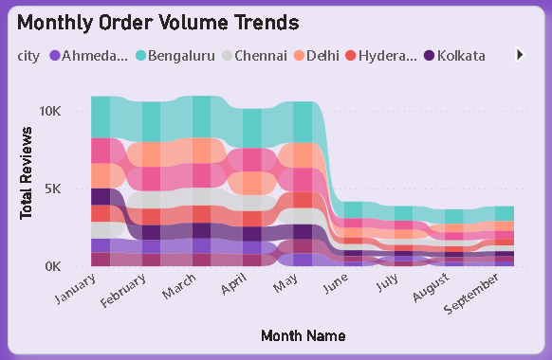
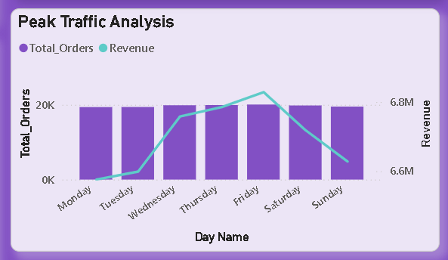
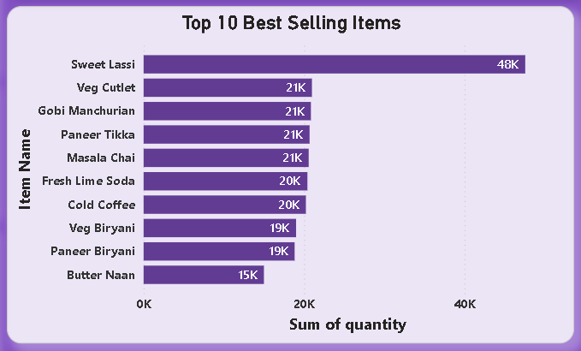
Top Visualization`s
Illustrates how order volumes change over time across different cities. It helps detect seasonal demand shifts and identify strong vs. weak geographic markets.
Analyzes order volume and revenue across days of the week to find peak business periods. This helps optimize staffing, delivery resources, and promotional timing.
Displays the highest-demand menu items based on quantity sold.It highlights core revenue drivers and supports inventory planning, promotions, and menu focus.

Slide 4
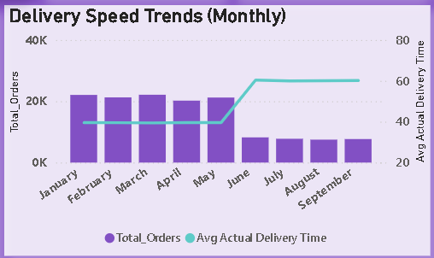
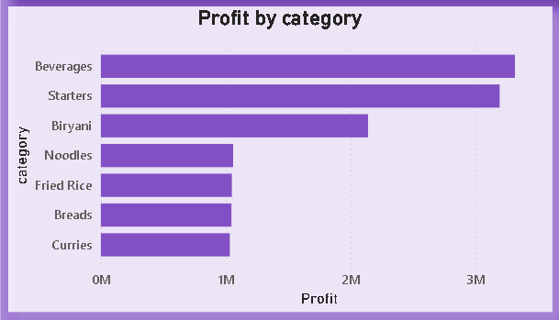
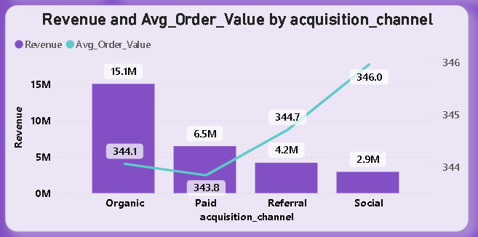
Top Visualizations
Tracks monthly delivery performance by showing order volume alongside average delivery time. It reveals operational slowdowns or efficiency improvements affecting customer satisfaction.
Shows which food categories generate the highest profit contribution. This supports menu engineering decisions like promoting high-margin categories and revising low-margin ones.
This visual compares total revenue and average order value (AOV) across customer acquisition channels. It helps identify which channel brings high volume vs. high-spending customers, guiding marketing budget allocation.

Slide 5
EXECUTION MILESTONE
DETAILS
Milestone 1 — Data Collection & Pre-Processing
Purpose: To prepare a clean, reliable, and analysis-ready dataset as the foundation for all dashboards.
Outcome: A structured and optimized dataset enabling accurate analytics and KPI calculations.
Milestone 2 — Core Business Performance Dashboards (1 - 3 Dashboards)
Purpose: To establish visibility into overall business health and operational performance.
Outcome: Provided a high-level operational and financial overview for strategic decision-making.
Milestone 3 — Advanced Customer & Sentiment Analytics (4 & 5 Dashboards)
Purpose: To understand customer satisfaction and demand patterns beyond raw sales.
Outcome: Enabled customer experience monitoring and data-driven improvements in service quality.
Milestone 4 — Profitability & Restaurant Optimization (6 & 7 Dashboards)
Purpose: To shift focus from revenue to profitability and operational efficiency.
Outcome: Helped identify profitable items, underperforming categories, and opportunities for menu and restaurant-level optimization.

Slide 6
Datasets Used
dim_customer.csv
dim_delivery_partner_.csv
dim_menu_item.csv
dim_restaurant.csv
fact_delivery_performance.csv
fact_order_items.csv
fact_orders.csv
fact_ratings.csv
Balaji Fast Food Sales.csv

Slide 7
Key Learnings & Skills Gained
This project offered a comprehensive learning experience, covering technical proficiency, analytical acumen, and crucial soft skills. We mastered data handling, modeling, and advanced DAX expressions, alongside dashboard design and optimization. The project also honed our ability to generate actionable business insights and effectively present complex findings.
TECHNICAL LEARNINGS
ANALYTICAL LEARNINGS
SOFT SKILLS
Data Cleaning & Pre-Processing
Data Modeling (Star Schema)
DAX: Measures for KPIs (Revenue, Profit)
Dashboard Design & Optimization
Business Insight Generation
Menu Engineering & Optimization
Customer Behavior Analysis
Operational Performance Evaluation
Enhanced Analytical Thinking
Improved Business Understanding
Effective Report Structuring
Strong Presentation & Explanation

Slide 8
Challenges Faced & Resolutions
Data Quality Issues
Resolved through data cleaning, standardization, and calculated fields.
Complex Data Modeling
Solved by designing star schema and optimized relationships.
KPI Calculation Complexity
Handled using advanced DAX measures and time intelligence.
Visual Clarity Challenges
Improved layout with focused KPIs and structured dashboards.
Revenue vs Profit Confusion
Solved with Menu Engineering Matrix for profitability analysis.
Customer Sentiment Analysis
Built sentiment dashboards to identify dissatisfaction drivers.

Slide 9
Key Insights from Analytics
High Performer Items
A small group of menu items drive the majority of revenue and profit.
Customer Retention Drivers
Organic and Referral channels show higher repeat customer rates.
Operational Bottlenecks
Delivery time spikes correlate with higher negative feedback.
Business Impact & Value Delivered
Revenue Growth Opportunities
Identified products and categories with potential for scaling sales.
Cost & Margin Optimization
Highlighted low-margin items for price or cost adjustments.
Customer Experience Improvement
Insights help reduce delays and improve satisfaction ratings.

Slide 10
Acknowledgement & References
I would like to express our heartfelt gratitude to:
Infosys Springboard Team– for organizing this valuable internship opportunity.
Our Mentor(Nityasree mam) - for her continuous support and feedback.
My Teammates(Garvit Rajpoot, Vanshika) – for collaboration, encouragement, and insights
This internship has been a significant step in our professional growth and technical journey.
References:
Microsoft Power BI Documentation - Food_trend.pbix
Infosys Springboard Virtual Internship course materials - Dataful and Kaggle

